Slide 1
Develop a Sentiment Analyser
By: Saleh Mohamed
Supervisor: Dr. Mabrouka Abuhmida
Notes:
Beginning of the presentation for project

Slide 2
Aim and Motivation
The aim of this project was to research, design and produce a sentiment analyser which can obtain digital online texts and analyse them to understand the sentiment (or emotion) that they contain.
The project revolved around obtaining extensive research into the field of sentiment analysis as well as producing various designs for the system being developed and finally programming the system.
This topic was chosen as it seemed a rather interesting and enjoyable experience to be able to develop a program that can deconstruct online texts which people post and see what kind of emotion they are expressing.
In addition, it also provided a chance to improve skills in programming as well as designing and developing a system.
Furthermore, it also led to an improvement in planning and time management skills as it required various tasks and objectives to be completed by specific dates in order for the project to progress smoothly.
Notes:
Discuss why you chose this project and what you gained from it. Talk about what the project revolved around and mention the overall purpose and objective of the given project and what it was meant to accomplish.
Discuss the benefits that it provided. How managing tasks led to greater project management skills.
The project was beneficial as it enabled a greater amount of experience to be acquired in the field of programming whilst also allowing a significant amount of knowledge to be obtained through extensive research.
It also enabled experimenting with different design ideas when it came to designing and producing the system. This resulted in further creativity when deciding on how the system at hand should be developed and what it should look like.

Slide 3
Presentation overview
Introduction
Background
Related work
Implementation and design
Project schedule
Risk Assessment

Slide 4
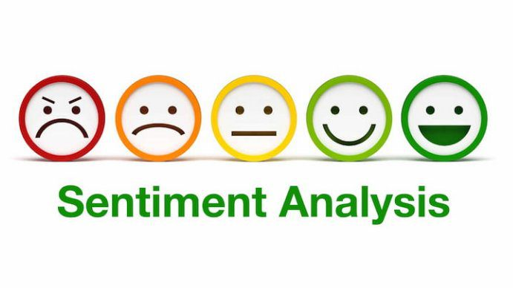

Introduction
Sentiment Analysis is a growing field in the area of Computer Science and has gained immense popularity and use due to the fact that it is used as a means of analysing online texts which people around the world use to convey their opinions on social media and then attempt to understand the emotion that it may contain.
Many people use social media on a daily basis to express their views and opinions regarding various topics and so it is important to have a means of obtaining the emotion that these views contain in order to better understand the views that people are expressing. This is achieved through sentiment analysis.
Notes:
The basics of sentiment analysis. Explain What it is, why people use it and why it is useful. Basically provide a summary or an overview of sentiment analysis in order to convey a basic understanding of it.

Slide 5


Cont. Introduction
Sentiment Analysis is thus becoming incredibly useful in modern society as a way of understanding how people feel towards various different topics. At the same time, as technology continues to change and advance, so does the field of sentiment analysis. As a result, the need for sentiment analysis is becoming increasingly prominent.
Moreover, as sentiment analysis becomes more and more important, different forms of sentiment analysis have become apparent and different ways of conducting sentiment analysis have come to light.
Thus, this has enabled people to accomplish various tasks using a variety of different types of sentiment analysis, each having its own uniqueness.
Notes:
Continue to explain the basics of sentiment analysis and its importance in the computing world. Explain its impact on modern society.

Slide 6
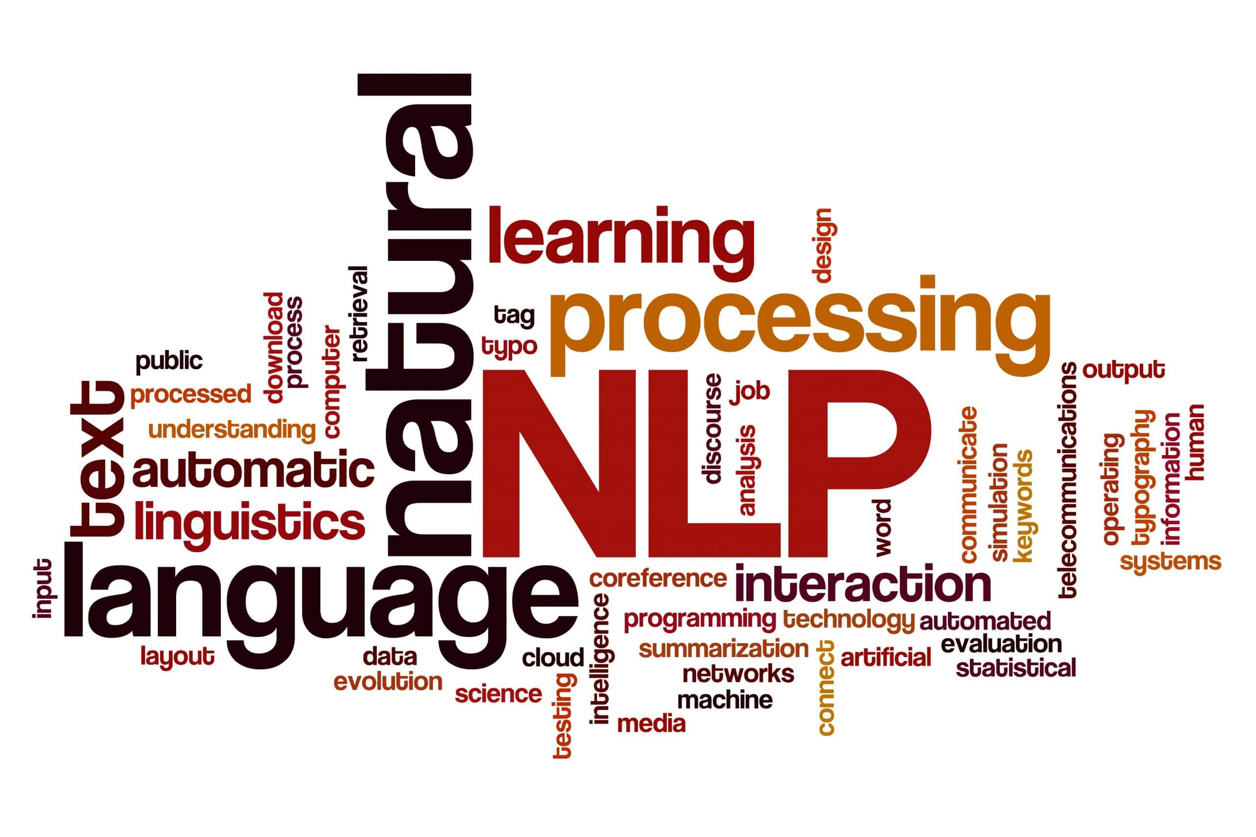

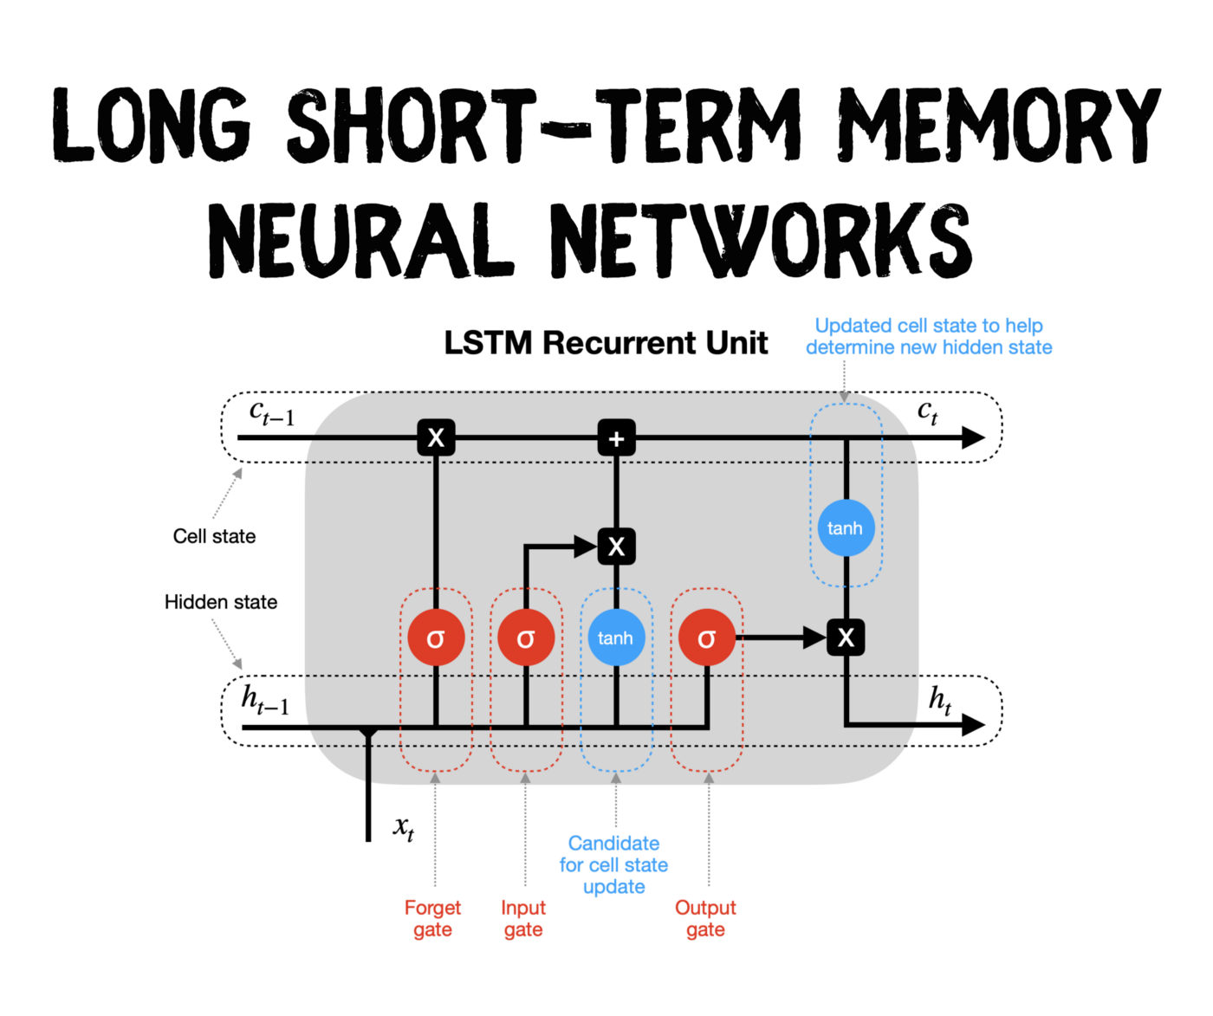
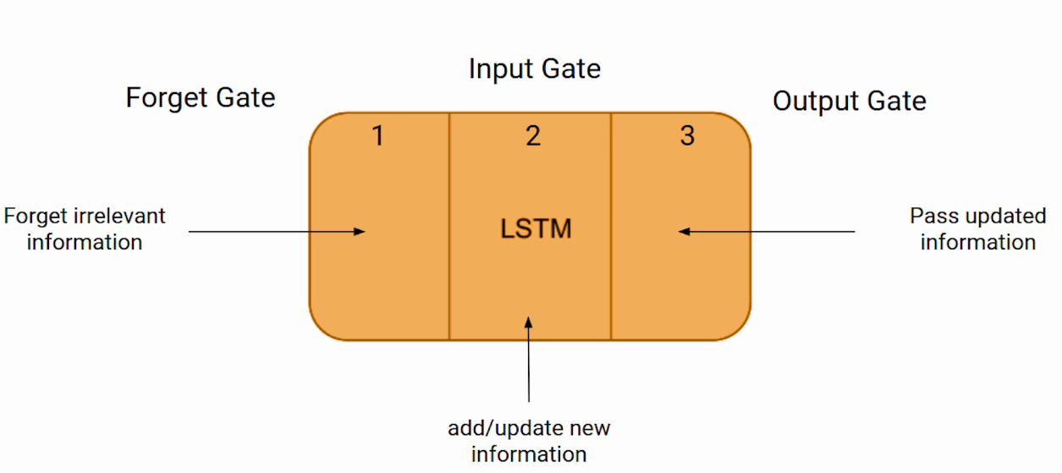
Background
Sentiment Analysis seeks to understand, obtain as well as address various states that are sentimental in a way that is systematic and is now one of the most active areas of research in the field of mining text. Moreover, one of the key areas 0f Natural Language Processing (NLP) is to utilise Artificial Intelligence in its different takes on designing and creating computational platforms. Sentiment Analysis can be considered the process of gathering a text’s contextual polarity and categorising it as either positive, negative or neutral.
Sentiment Analysis can be split into three process stages including Sentiment Identification, Feature selection and Sentiment classification. With sentiment identification, the document in its entirety is seen as the base for categorising an opinion within the document. In comparison, in feature selection, every sentence is provided with a classification. Finally, with sentiment classification, the sentiments are provided with a classification based off the particular elements of entities that are determined at the start of this process. [1]
Furthermore, in recent years, deep neural networks have played a role in various tasks conducted by sentiment analysis and have resulted in increased efficiency. One type of neural architecture that is used by sentiment analysis is Long Short-Term Memory (LSTM). [2]
Notes:
Background research into the topic. Discuss the purpose of sentiment analysis in more detail, and information obtained through research. Discuss Natural Language Processing NLP as well as the different process stages of sentiment analysis.
Also mention Long Short-Term Memory.

Slide 7
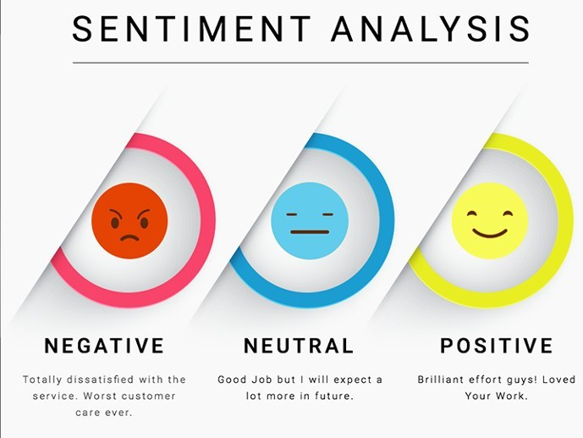

Cont. Background
As well as sentiment analysis having different stages for processing data, there are also different forms of sentiment analysis like document-level sentiment analysis and aspect-based sentiment analysis. With document-level sentiment analysis, it aims at providing the overall polarity for a document that is complete.
Document-level sentiment analysis goes by the assumption that the particular document has a text that is opinionated only on a single entity. Whilst sentiment analysis at sentence-level prioritises analysis that is fine-grained through the use of obtaining sentiment contained within sentences.
In comparison, sentiment analysis that is aspect-based is split up into four tasks being; aspect term extraction, aspect term polarity, aspect category as well as aspect category polarity. With aspect term extraction, the aim is to identify the aspect terms which are contained within a sentence.
Aspect term polarity focuses on obtaining the given polarity of all of the aspect terms that are in a sentence whilst aspect category detection prioritises the identification of aspect categories that are within a predefined set. Lastly, aspect category polarity revolves around classifying every aspect’s polarity as either positive, negative or neutral. [3]
Notes:
Discuss the various process stages for sentiment analysis as well as the different types of sentiment analysis, i.e. document-level and aspect-based.
Provide an overview and explanation of document-level sentiment analysis and aspect-based sentiment analysis. In addition, also discuss the tasks that revolve around aspect-based sentiment analysis. E.g. aspect term extraction, aspect term polarity, aspect category and aspect category polarity.
Finalise discussing background research into sentiment analysis.

Slide 8
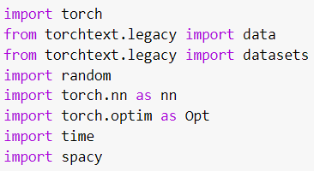


Demo - Code
The main system was built off of Python code written in Google Colab. The code was placed into various classes and functions, with each part maintaining an important role on the program as a whole. The classes and functions were given names that were fairly self-explanatory, so that their purpose was made easier to understand.
In order to get the program to work, a number of different software packages needed to be installed including Anaconda. Anaconda was needed as it contained the features for PyTorch, which was what the program revolved around. Anaconda enabled various APIs to be used in the program, thus allowing the system to run and function correctly.
Moreover, it also required a pip install of torchtext and spaCy as these were library features which provided functionality to the system. These features allowed the system to perform efficiently and were a pivotal part in getting the system up and running.
Notes:
Discuss creating the base or “backbone” of the system, that being the source code. Explain how the code was produced and structured and what features were necessary in order to get the code to run properly and thus get the system to work.
Talk about the various software packages, like Anaconda and PyTorch and how they were essential in getting the system to function as expected and conduct sentiment analysis efficiently.
Also mention torchtext and spaCy and how they were an important part of the system.

Slide 9
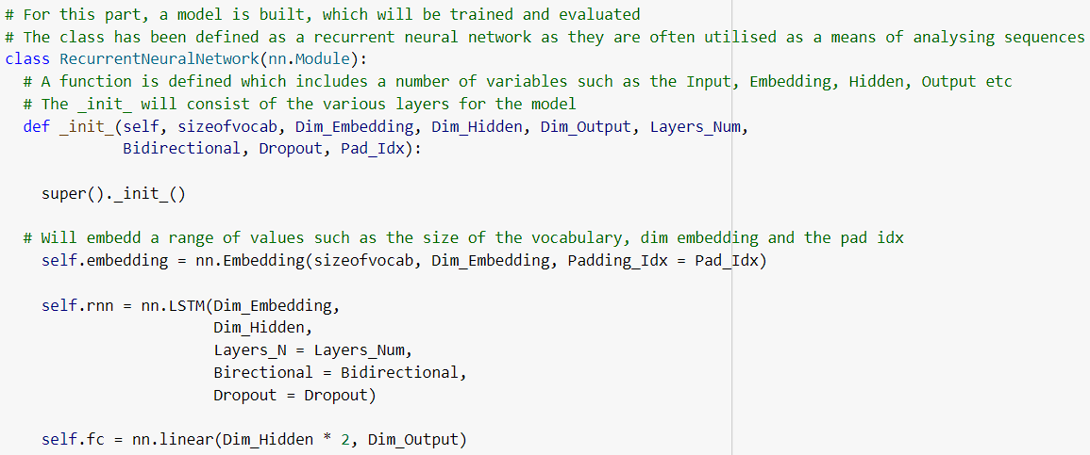

Demo - Code
In addition, the program also made use of a Recurrent Neural Network (RNN), which was the main class of the system and contained a number of separate functions within it.
The program in its entirety revolved around obtaining data from the IMDb dataset (movie reviews) and analysing the data to understand the sentiment (or emotion) that they contained.
This included analysing what people thought about various movies that have been reviewed on the IMDb website and deciding whether the views they have expressed are positive or negative.
Furthermore, the code also contained a variety of comments, which provided a detailed explanation of what the code does and thus making it easier to understand and interpret. Thus, as well as providing variables and functions with names that are fairly easy to understand, the comments gave an even more detailed explanation.
Notes:
Discuss Recurrent Neural Networks (RNN) and how the system revolved around them. Also mention how the Recurrent Neural Network class contained a handful of functions that each had their own part in contributing to the system.
In addition, also discuss how the system conducted sentiment analysis, e.g. getting data from the IMDb dataset and analysing the data to see the views which people had on movies and then classifying them as positive or negative.
Finally, talk about how the code also contained a number of comments which helped explain exactly what the code does and what its purpose was.

Slide 10
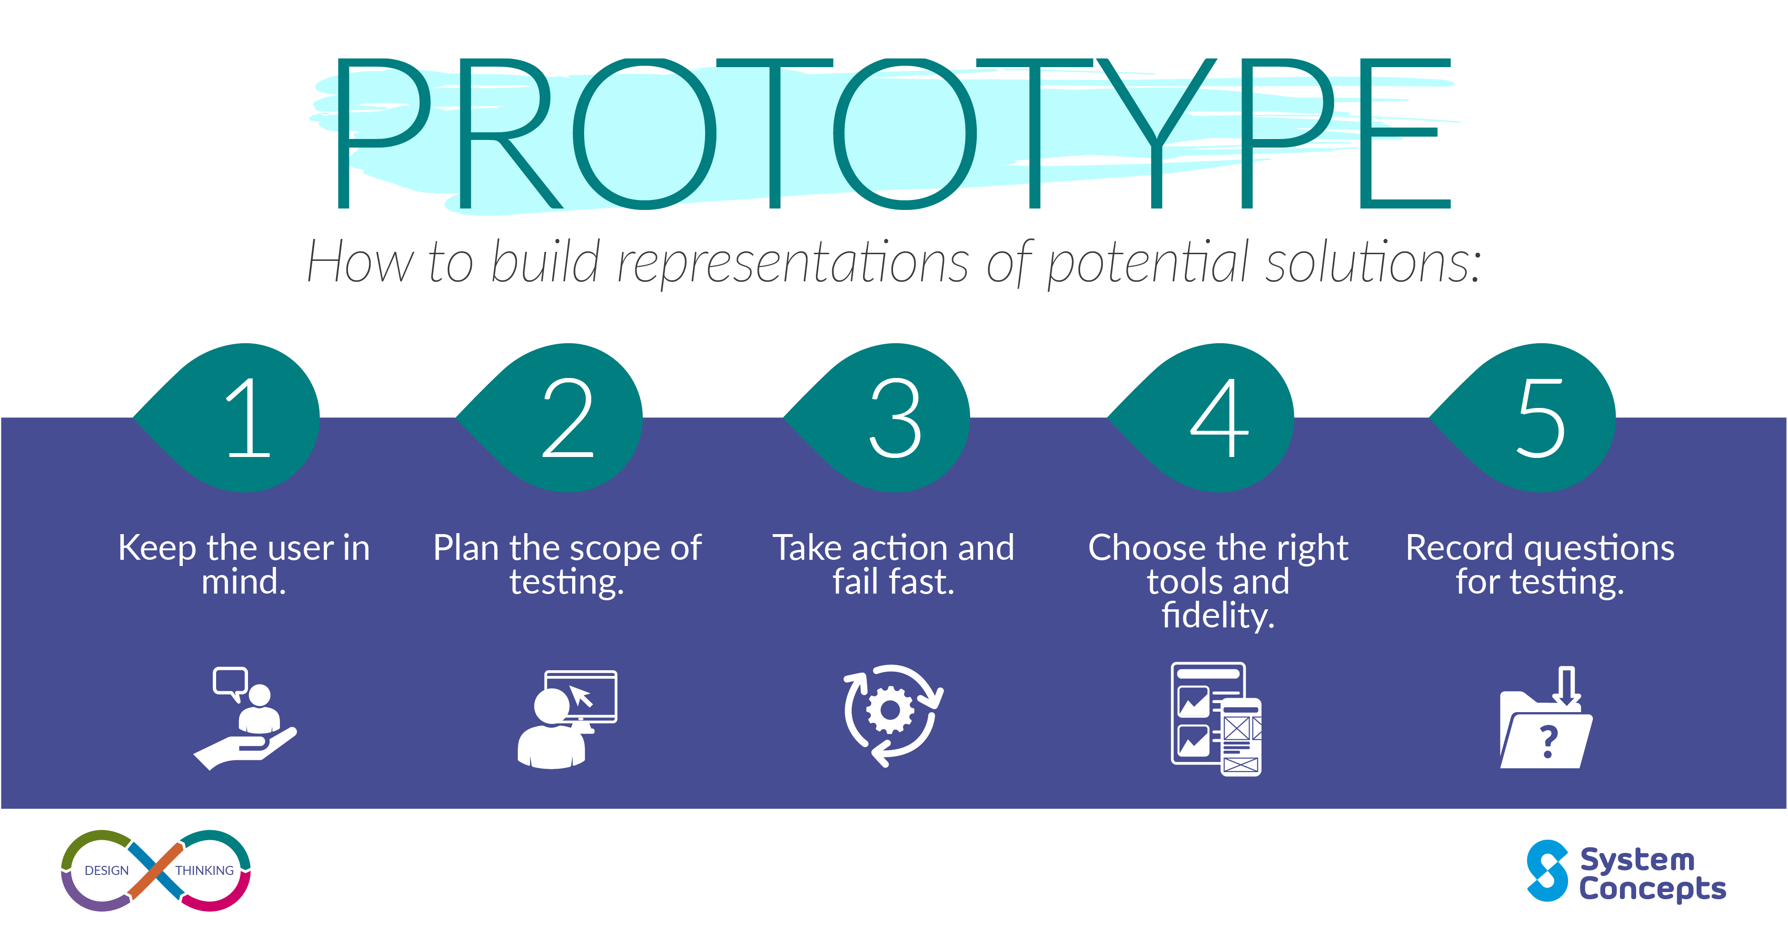
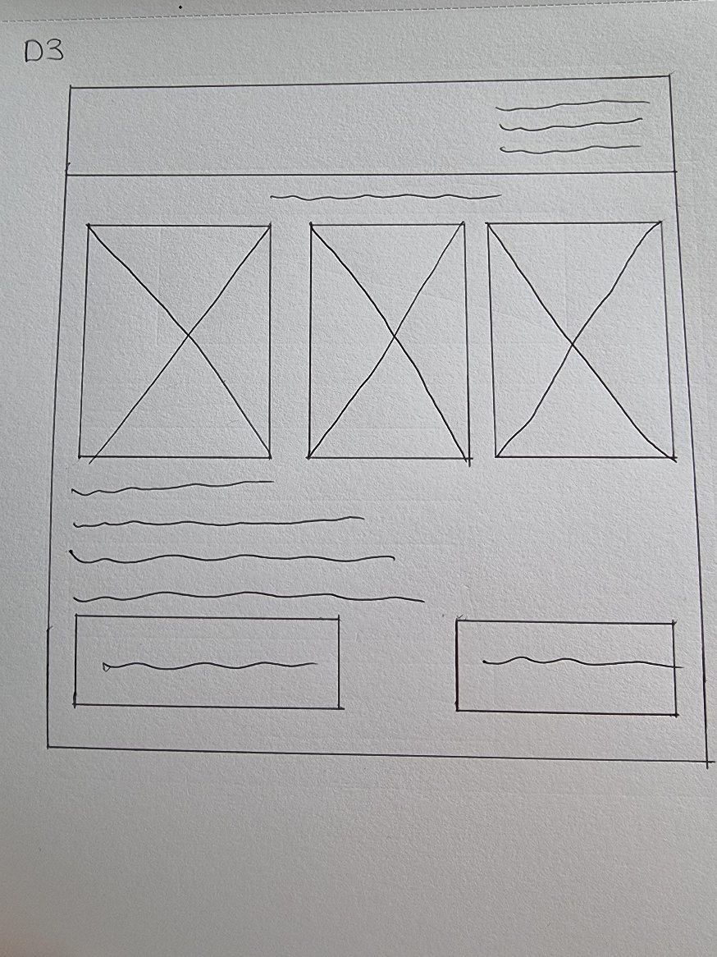

Prototype design
The project itself contained a number of different designs for the prototype with the sentiment analyser being coded in Google Colab as the main source code and then being connected to a user interface designed on the online tool Anvil.
When writing the code for the sentiment analyser in Google Colab, it went through various changes and alterations to ensure that it contained all of the core functionalities in order for the sentiment analyser to work properly and be able to conduct its tasks efficiently. This included modifying aspects of it to make it more efficient.
Thus, in-depth research was undertaken to make sure that the correct code was used when developing the system. Moreover, the code itself was written using the Python programming language and the majority of it was placed into classes and functions to make it look neater and more professional.
Likewise, in order to get a better idea and understanding of what the system should look like, sketches were produced as an indication of the various features that the system could have.
Notes:
Talk about how a prototype of the system was produced and how exactly it was designed. Also mention that it went through a variety of iterations and stages, with the code being altered constantly in order to improve it and make it more efficient.
Discuss that research was conducted in order to gain a good understanding as to what kind of code should be used in the system and to ensure that all of the necessary elements were included in order to get the system to run efficiently.
Also discuss the designs that were produced in order to have a good indication as to what the system should look like and what features the interface should have.

Slide 11
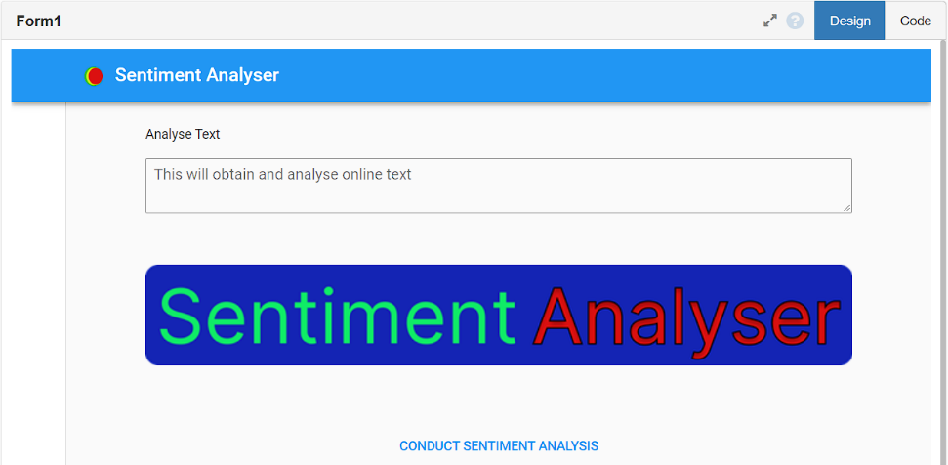

Cont. Prototype design
Upon completing the code in Google Colab, it was tested to ensure that it worked properly before the Anvil user interface was designed and developed, containing the necessary elements for the user to be able to successfully conduct sentiment analysis.
The interface was designed with the intention of making it user-friendly and easy to use whilst also making sure that it included all of the essential features for sentiment analysis to take place.
The interface itself had been given a direct connection to the source code in Google Colab so that it would have access to the necessary elements in order to run the system.
The interface was also provided with a logo and title f0r the sentiment analyser. Both of these were designed and produced using the online tool Figma. They were designed as it seemed more professional and adequate to provide the system with its own unique features and make it more appealing.
In addition, the logo at the top right of the screen was given the colours, green, yellow and red to signify positive, negative and neutral.
Notes:
Discuss code being tested before the interface was created and provided with functionality.
Talk about how the interface itself was designed and produced. Explain that the interface was connected to the source code and that it was given a logo as well as a title.
Discuss how the logo and title were designed, why they were produced and then how they were applied to the interface.
Mention design decisions, e.g., choice of colours for the logo

Slide 12
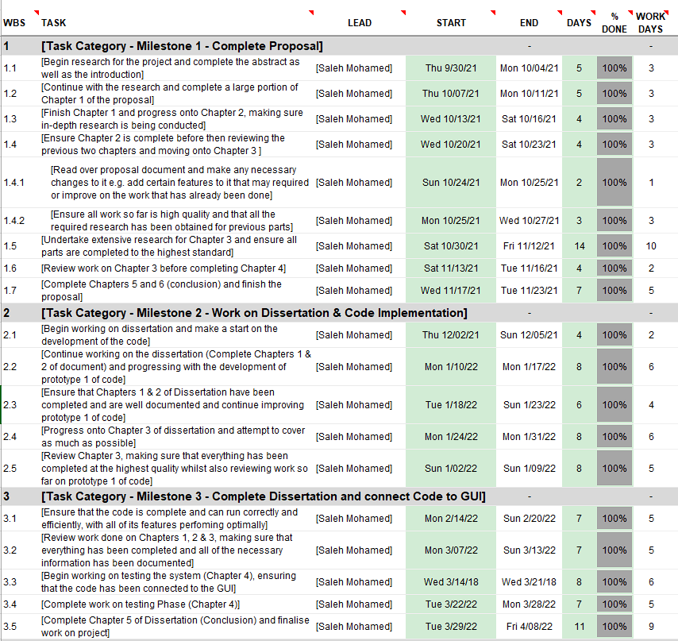
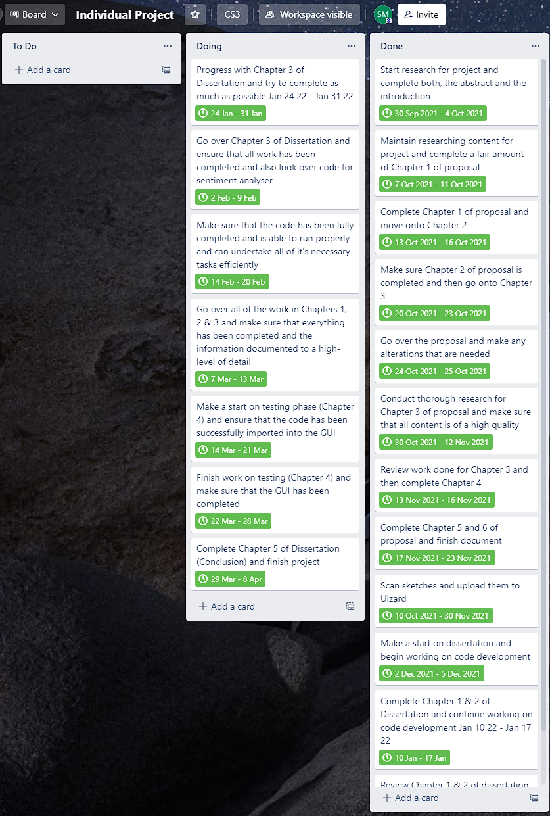
Project schedule
The project was managed through an Excel Spreadsheet and Trello Board, with various tasks given specific dates to be completed by. The tasks were given different timeframes, with the more difficult and challenging tasks provided with a greater amount of time to complete.
Both, the Trello Board and the Excel
Spreadsheet were useful when being
used throughout the duration of the
project as they gave a clear indication
as to what tasks needed to be completed
and when they needed to be completed
by.
Moreover, with the Trello Board, after
each task had been completed, it allowed
the task to be marked as being done to
avoid confusion.
Notes:
Discuss the process of planning each of the tasks throughout the course of the project duration and also managing the different tasks i.e. prioritising the most difficult tasks and the most important ones first.
Talk about time management and being able to plan accordingly and ensuring that the tasks are completed by a given date. Discuss using the Excel Spreadsheet and the Trello Board to organise and manage the various tasks between each phase of the project.
Also discus the advantages of the Trello Board when completing the tasks.

Slide 13



Risk Assessment
The project as a whole did not include many risks (excluding time management) and was not dangerous in any way. As a result, risk assessment was not an issue when completing this project.
This was handled in the Ethics form.
The project revolved around designing and producing a system that can obtain online texts and analyse the views that people are expressing from those texts and thus, unless someone were to deliberately alter the system with malicious intent, there isn’t really any way that the project could have harmful effects.
Notes:
Talk about the risks to the project (if any) and how they affected the project at hand. Briefly mention the ethics form.
Discuss how the project was not really dangerous at all and did not pose any risks when completing it and justify it e.g. simply developing a system that can analyse people’s opinions and therefore did not pose any serious danger at all.

Slide 14
References
https://ieeexplore.ieee.org/abstract/document/9454169 [1] Zad et al., 2021
https://www.sciencedirect.com/science/article/pii/S0167739X20309195?casa_token=-1Oyo6Lwl04AAAAA:Yqk_UUd_BXaCHocm7q9GquvxhHkGb0PNmOuKaxeDucSmVjuTm2F-FfKIvCdkPMyhSnG3cvb1xCs [2] Basiri et al., 2021b
https://www.sciencedirect.com/science/article/pii/S156849462100363X?casa_token=bRGAFKjpfIUAAAAA:f-m2x0wlX75h4gRofUCnztnL6SGZwe6HyiFD4CpopsE7GGhDOPUEIJrXiuFkbJHREn41QHgjfjg [3] Pathak et al., 2021
Notes:
List of references used to obtain background research for sentiment analysis.

Slide 15
Thank you!
Any Questions

